Slide 1
Lecture 7:
E-R Diagram
Database Systems

Slide 2
In the last lecture
4.4 SELECT문(계속)
Join
  Used to combine rows from two or more tables based on a related column between them
Nested query
  SELECT statement included in the WHERE clause of the outer query again in the form SELECT ... FROM ... WHERE
  The result of a nested query can return
  A scalar value (single value)
  A relation with one attribute
  A relation with multiple attributes

Slide 3
What is E-R diagram?
Part 1

Slide 4
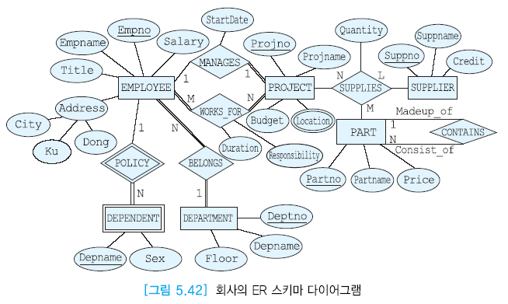
1. E-R Diagram
Entity-Relationship Diagram (E-R Diagram)
  Expressing the real world as entities, attributes, and relationships between entities

Slide 5
1. E-R Diagram
E-R diagram
  To facilitate database design, proposed by P.P. Chen in 1976
    Currently, Enhanced Entity Relationship (EER) models are widely used in the database design process.
  ER diagrams are transformable into relational tables which allows you to build databases quickly
  Provide a preview of how all your tables should connect, what fields are going to be on each table
  Easy to learn with little effort and easy to understand even if you are not an expert

Slide 6
E-r Diagram components
Part 2

Slide 7
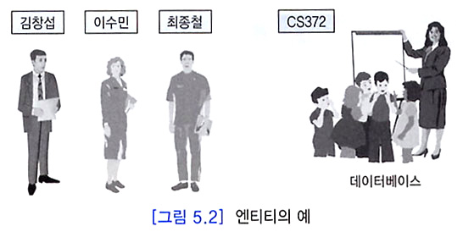
2. E-R Diagram Components
Entity
  An entity is an object about which you want to store information
  A set of entities are entity type
  In E-R diagrams, entity types are represented as rectangles

Slide 8
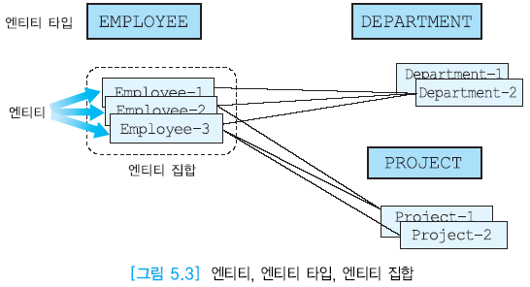
2. E-R Diagram Components

Slide 9
2. E-R Diagram Components
Strong entity type
  Strong entity type (regular entity types) can uniquely identify the entity using its own key attribute
Weak entity type
  Weak entity is dependent on strong entity
    Cannot exists without a corresponding strong entity
    Weak entity type does not have enough attributes to form a key
  Marked as Double Line Rectangle in E-R Diagram

Slide 10
2. E-R Diagram Components
Attributes
  One entity is described as a set of associated attributes
    Example: an employee entity has attributes such as Employee Number, Name, Title, and Salary
  A key attribute is an attribute or collection of attributes that uniquely identifies each entity within an entity type.
    Attributes belonging to primary key in ER diagrams are underlined
  Attributes are represented as Oval in E-R diagram and connected to entity types by solid lines

Slide 11
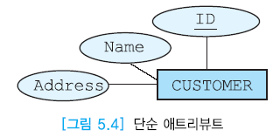
2. E-R Diagram Components
Simple attribute
  Most attributes in ER diagrams are simple attributes
  Shown as solid oval in ER diagram

Slide 12
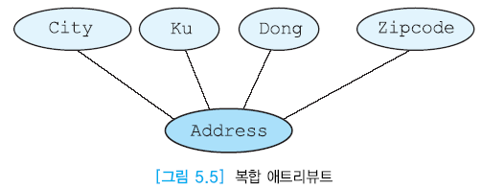
2. E-R Diagram Components
Composite attribute
  An attribute consisting of two or more attributes
  A collection of closely related attributes of the same entity type or relationship type

Slide 13
2. E-R Diagram Components
Single-valued attribute
  Attribute with exactly one value for each entity
  Same representation as a simple attribute in an E-R diagram
    Example: The employee number attribute of an employee is a single-valued attribute because no employee has more than one employee number.
  Most attributes in an E-R diagram are single valued attributes.

Slide 14
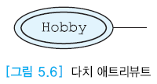
2. E-R Diagram Components
Multi-valued attribute
  An attribute that can have multiple values for each entity
  Expressed as double line ellipse in E-R diagram

Slide 15
2. E-R Diagram Components
Stored attribute
  An attribute which are physically stored in the database
  Same representation as a simple attribute in an E-R diagram
  Most attributes in an E-R diagram are stored attributes.
  Example:
    Assume a table called as student. There are attributes such as student_id, student_name, student_email. We cannot derive value of these attribute using other attributes.

Slide 16

2. E-R Diagram Components
Derived attribute
  Attribute obtained from the value of the other attribute
  Represented by dotted ellipse in ER diagram

Slide 17
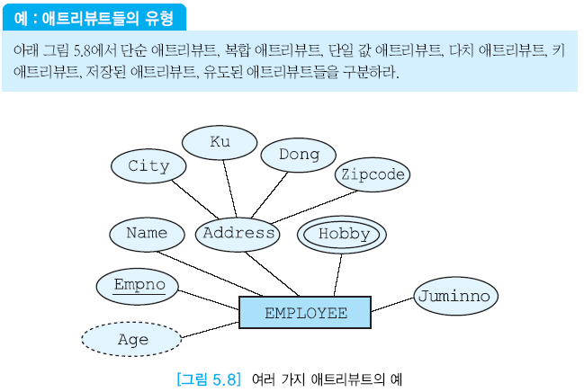
2. E-R Diagram Components

Slide 18
2. E-R Diagram Components
Relationships and Relationship Types
  Relationship is a connection between entities that can be thought of as a mapping between two or more entity types.
  Verbs are often represented as relations in the E-R diagram in the requirements specification.
  Marked with diamonds in the E-R diagram

Slide 19
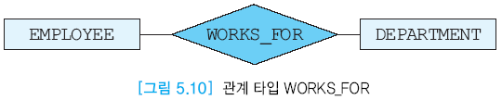
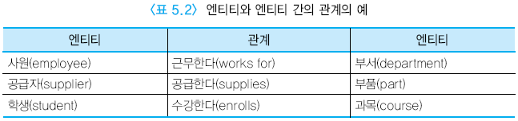
2. E-R Diagram Components
Relationships and Relationship Types

Slide 20
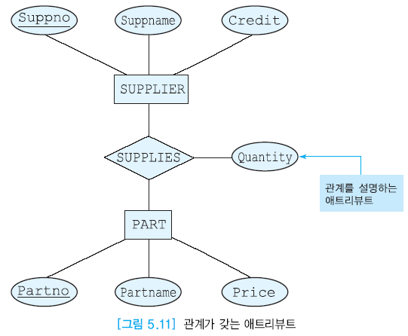
2. E-R Diagram Components
Attribute of the relationship
  Relationship types can have attributes that describe the characteristics of the relationship
  Relationship type does not have a key attribute

Slide 21
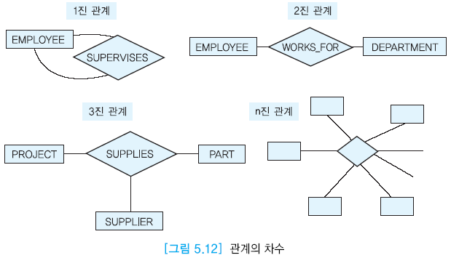
2. E-R Diagram Components
Degree
  The number of entity types connected in a relationship
  The most common relationship in the real world is a binary relationship that connects two entity types.

Slide 22
Quiz
Create your own E-R Diagram that contains two entity types and connect them with relationship
For your entity types, include the following attributes:
  Primary key attribute
  Simple attribute
  Composite attribute
  Multi-valued attribute
  Derived attribute
  Relationship attribute

Slide 23
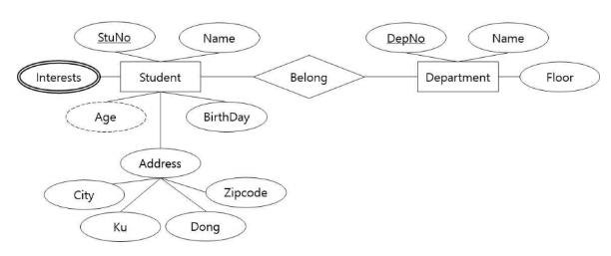
2. E-R Diagram Components
Examples
  Primary Key -> CORRECT
  Composite Attribute -> CORRECT
  Multi-valued Attribute -> CORRECT
  Derived Attributes -> CORRECT
  Naming -> CORRECT, but incorrect GRAMMAR

Slide 24
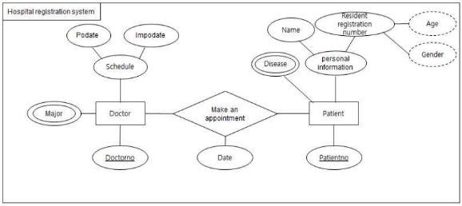
2. E-R Diagram Components
Examples
  Primary Key -> CORRECT
  Composite Attribute -> CORRECT, but do not use nested composite attributes
  Multi-valued Attribute -> CORRECT
  Derived Attributes -> CORRECT, but connect them to entity type
  Naming -> CORRECT, but incorrect GRAMMAR

Slide 25
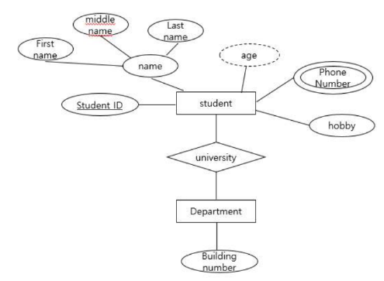
2. E-R Diagram Components
Examples
  Primary Key -> CORRECT, but one is missing
  Composite Attribute -> CORRECT
  Multi-valued Attribute -> CORRECT
  Derived Attributes -> INCORRECT
  Naming -> INCORRECT

Slide 26
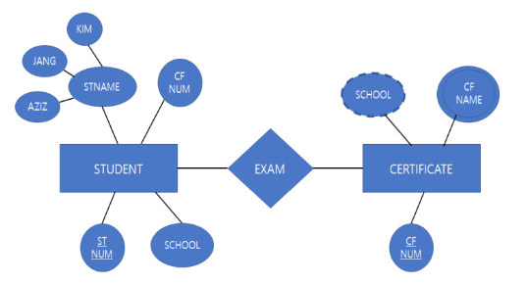
2. E-R Diagram Components
Examples
  Primary Key -> CORRECT
  Composite Attribute -> INCORRECT
  Multi-valued Attribute -> STRANGE
  Derived Attributes -> STRANGE
  Naming -> INCORRECT

Slide 27
Cardinality
Part 3

Slide 28
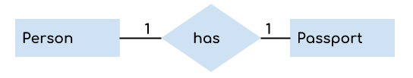
3. Cardinality
Cardinality
  Cardinality represents the number of relationships an entity can participate in
  Relationships are often divided into 1:1, 1:N, M:N
    Cardinality ratio
  Information on cardinality indicates over trunk of relationship

Slide 29
3. Cardinality
1:1 relation
  If each entity in A is correctly associated with one entity in B, and each entity in B is correctly associated with one entity in A
1:N relation
  If each entity in A is associated with any number of entities in B, and each entity in B is correctly associated with one entity in A
M:M relation
  Any number of entities belonging to one entity type are associated with any number of entities belonging to another entity type

Slide 30
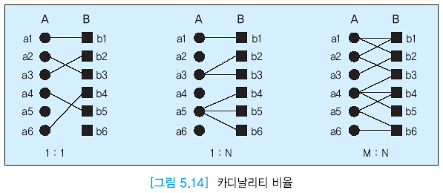
3. Cardinality
Cardinality ratios

Slide 31
3. Cardinality
Example

Slide 32
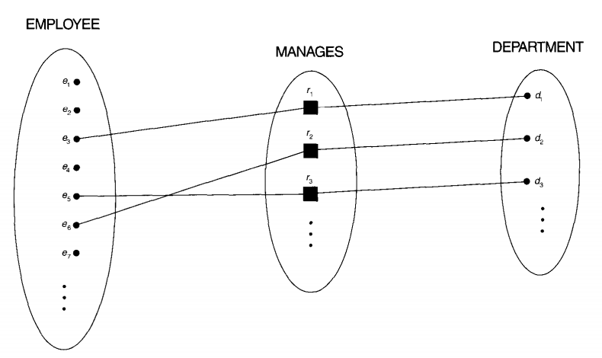
3. Cardinality
Example of 1:1 relationship
  One employee can manage only one department and one department can be managed by only one person (i.e., employee)

Slide 33
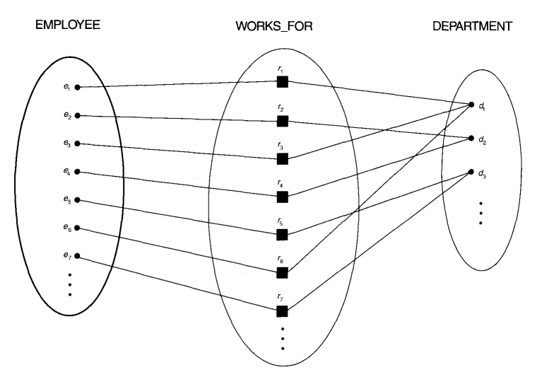
3. Cardinality
Example of 1:M relationship
  One employee can belong to only one department but a department can have many employees
belongs

Slide 34
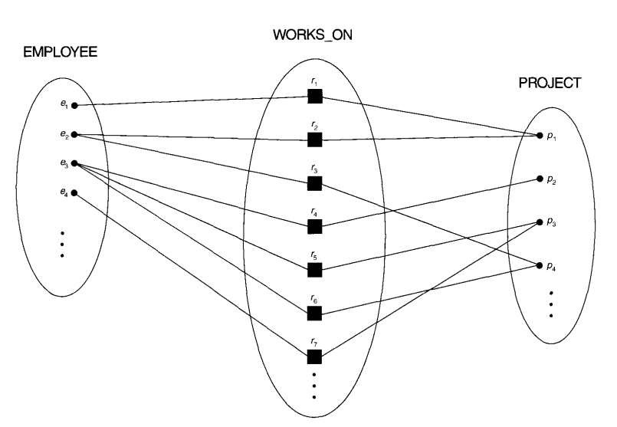
3. Cardinality
Example of M:M relationship
  One employee can work on several projects and a project can have many employees

Slide 35

3. Cardinality
Example of 1:1 relationship
  A person has only one passport and a passport is given to one person
Example of 1:M relationship
  A customer can place many orders but an order cannot be placed by many customers

Slide 36
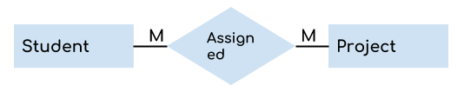
3. Cardinality
Example of M:M relationship
  A student can be assigned to many projects and a project can be assigned to many students

Slide 37
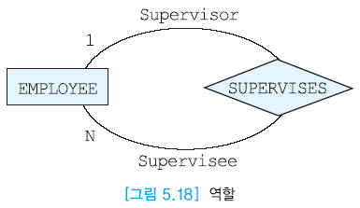
3. Cardinality
Role
  Used to clarify the meaning of the relationship type
  In particular, if an entity type appears multiple times in a relationship type, the role must be indicated.
  Display above edges of relationship type

Slide 38
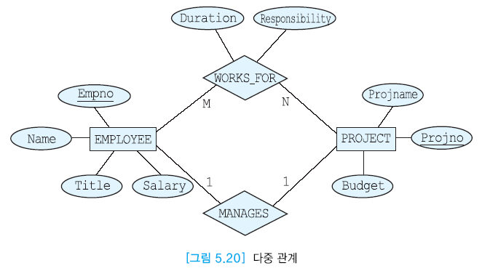
3. Cardinality
5.2 ER 모델(계속)
Multiple relations
  More than one relation type can exist between two entity types

Slide 39
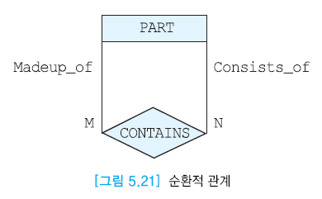
3. Cardinality
5.2 ER 모델(계속)
5.2 ER Model (Continued)
Circular relation
  An entity type participates more than once in the same relational type

Slide 40
Participation
Part 4

Slide 41

4. Participation
Full and partial participation
  Full participation
    In a relationship all entities of entity type are involved in the relationship.
  Partial participation
    Only some entities of entity type participate in a relationship
  Full participation is represented by double solid lines in the ER diagram

Slide 42
4. Participation
Example

Slide 43
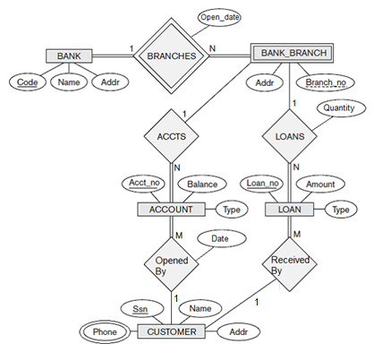
Summary
Example

Slide 44
See you next time!
Questions?

